Slide 1

CV1711 ENGINEERING DRAWING & 3D BUILD INFO MODEL (LAB)

Slide 2
Instructor Information
NAME: CUI SHUAIWEN (SHAUN)
EMAIL: SHUAIWEN001@e.ntu.edu.sg
TEL: 83071903
Any questions? Feel free to reach out!

Slide 3
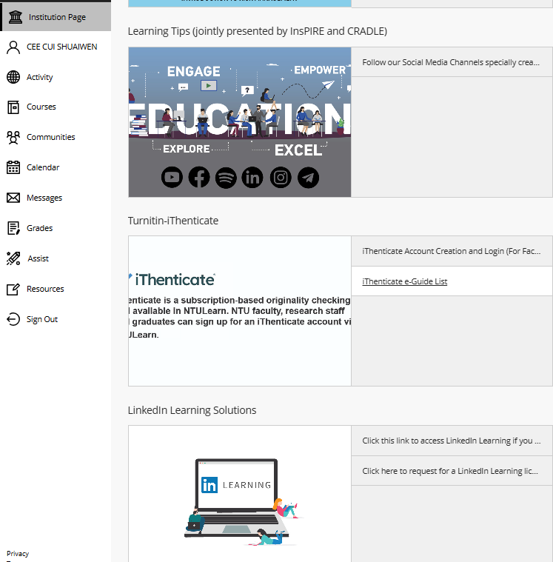
WEEK 1 & 2 – CAD Basics
Learn AutoCAD basics on NTULearn
Submit E2 by the end of week 2
After that, move on to week 3, 4, …
Linkedin Video Access Issue?
Mark your attendance before leaving
Save files & sign out before leaving
Any questions? Feel free to reach out

Slide 4
WEEK 3 – CAD Basics
Follow the instructions and videos on NTULearn
Submit E3 & E5 by the end of week 3
After that, move on to week 4 (orthographic projection), week 5 (auxiliary projection), week 6 … much more difficult, please preview the material before class.
Mark your attendance at the end of class
Save files & sign out before leaving
Any questions? Feel free to reach out

Slide 5

WEEK 4 – Orthographic Projection
Let’s watch this youtube video for basic understandings.
https://youtu.be/heIobpUVZqc?si=No0iEweG8M1roWwM

Slide 6
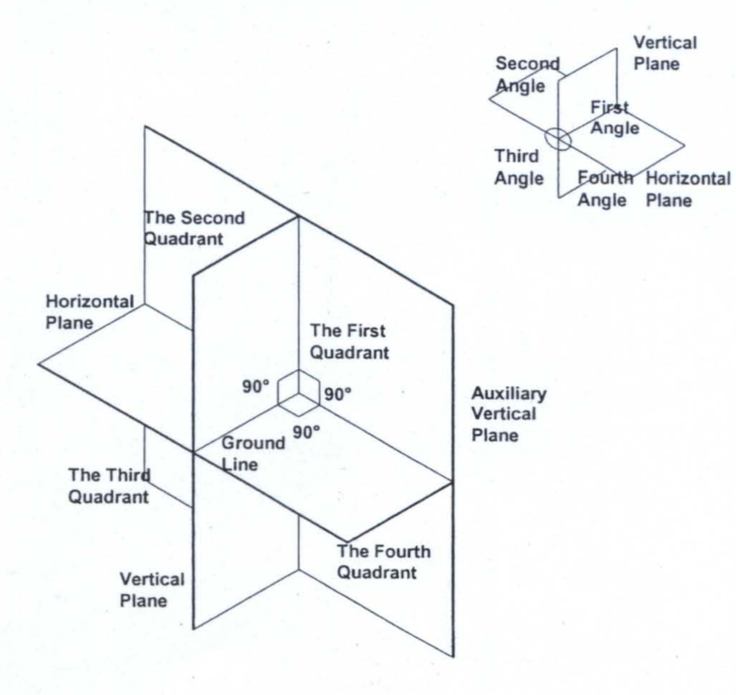

Quadrant System and Orthographic Projection
First Angle Projection
Third Angle Projection

Slide 7

Quadrant System and Orthographic Projection
First Angle Projection
Third Angle Projection
The Projection is behind the object.
The Projection is in front of the object.

Slide 8
First-angle projection:
T = elevation / front
S = end / side
P = plan / top
Unfold such that elevation view is adjacent to / center of other views.
First-angle projections are behind the object.
P
End 1
Elevation
End 2
Base
S2
Vertical partition
Lid
Vertical partition
Base
Horizontal partition
Horizontal partition
Plan
Lid
S1
T
Elevation is always on the vertical partition of the box.
Plan is always on the horizontal partition of the box.

Slide 9
First-angle projection:
Comment:
Notice that P may not be given, because plan view is always from above.
Variation 1
S
T
Not required
Lid
Vertical partition
Base
Horizontal partition
S
T

Slide 10
First-angle projection:
Variation 2
Comment:
The object is rotated.
Comment:
The layout stays the same because the object is simply rotated.
Not required
S
T
Lid
Vertical partition
Base
Horizontal partition
S
T

Slide 11
First-angle projection:
Comment:
The other end view is requested.
Variation 3
Comment:
Take note that the layout is different now. Because first-angle projections are behind the object.
Take note of the hidden line.
S
T
Not required
Lid
Vertical partition
Base
S
Horizontal partition
T

Slide 12
First-angle projection:
Comment:
The other end view is requested.
Comment:
Take note that the layout is different now. Because first-angle projections are behind the object.
Take note of the hidden line.
Variation 4
S
T
Not required
Lid
Vertical partition
Base
Horizontal partition
S
T

Slide 13
Third-angle projection:
T = elevation / front
S = end / side
P = plan / top
Unfold such that elevation view is adjacent to / center of other views.
Third-angle projections are in between the object and the viewer / in front of the object.
P
Plan
Horizontal partition
Base
S2
Horizontal partition
Lid
Vertical partition
Base
Vertical partition
End 1
Elevation
End 2
Lid
S1
T
Elevation is always on the vertical partition of the box.
Plan is always on the horizontal partition of the box.
Same as first-angle, even the locations of End 1 and End 2.

Slide 14
Third-angle projection:
Comment:
Remember, projections are in front of the object for the third angle.
Comment:
Notice that P may not be given, because plan view is always from above.
Variation 1
T
S
Horizontal partition
Lid
Vertical partition
Base
Not required
S
T

Slide 15
Third-angle projection:
Variation 2
Comment:
The object is rotated.
Comment:
The layout stays the same because the object is simply rotated.
T
S
Horizontal partition
Lid
Vertical partition
Base
Not required
S
T

Slide 16
Third-angle projection:
Variation 3
Comment:
Take note that the layout is different now. Third-angle projections are in front of the object.
Take note of the hidden line.
S
Comment:
The other end view is requested.
T
S
Horizontal partition
Lid
Vertical partition
Base
Not required
T

Slide 17
Third-angle projection:
Variation 4
Comment:
The final drawings are the same as Variation 1.
S
Comment:
The elevation view of the question has changed.
T
Horizontal partition
Lid
Vertical partition
Base
Not required
S
T

Slide 23
However, the question can be asked in different ways:
Variation 1
Comment:
This question is easy because the orientation aligns well with the box.
Notice that P may not be given, because plan view is always from above.
T
Not required
S
Lid
Vertical partition
Base
Horizontal partition
S
T

Slide 24
However, the question can be asked in different ways:
Variation 2
Comment:
The object is rotated.
Comment:
The layout stays the same because the object is simply rotated.
T
Not required
S
Lid
Vertical partition
Base
Horizontal partition
S
T

Slide 30
WEEK 4 – Orthographic Projection
First Quadrant
Plan is always below elevation
Project the view at the back of project
Plan is always above elevation
Project the view in front of the object plane
Third Quadrant
Direction T
Elevation View (first to draw)
Direction S
End of View
Distance from Horizontal & Vertical Plan must be equal for projecting points, lines &surface measurements from one view to another views
https://www.youtube.com/watch?v=heIobpUVZqc

Slide 31
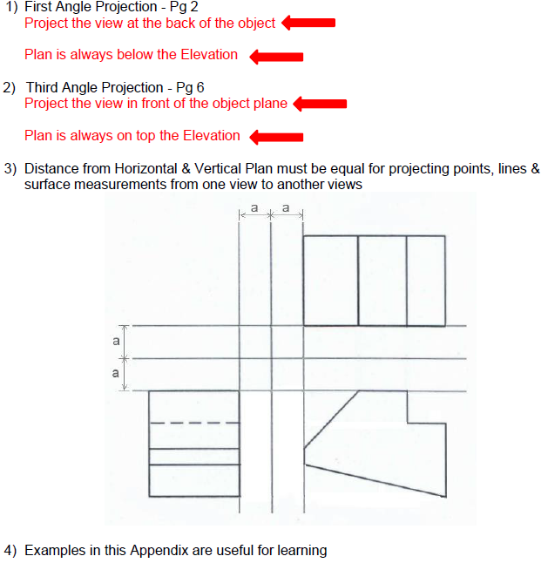
WEEK 4 – Orthographic Projection

Slide 32
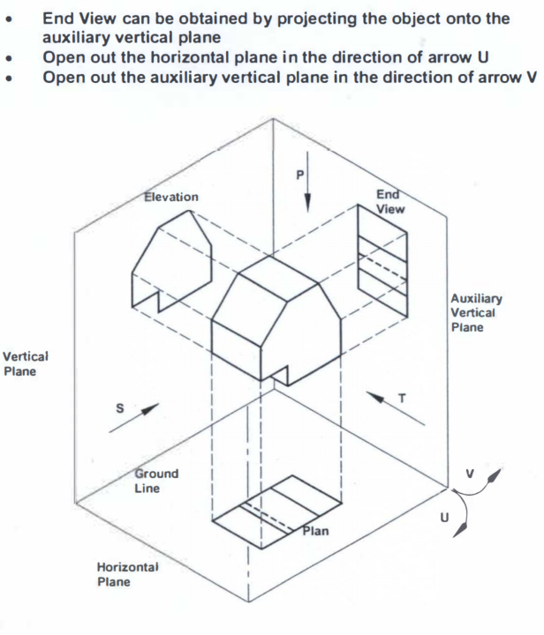
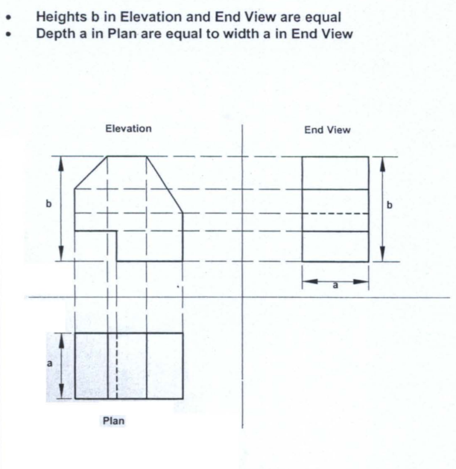
WEEK 4 – Orthographic Projection

Slide 33
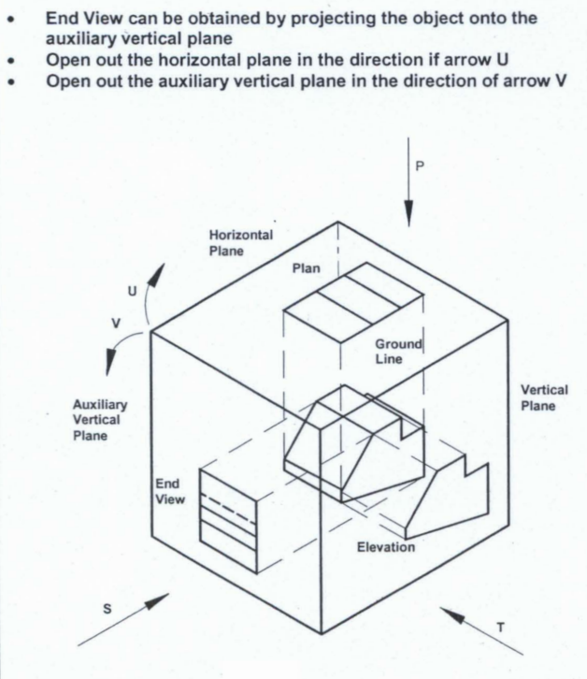
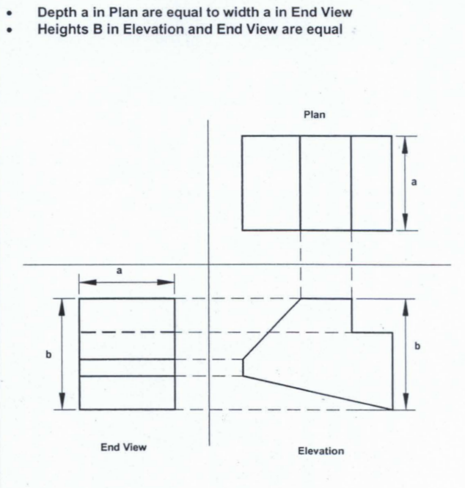
WEEK 4 – Orthographic Projection

Slide 34
WEEK 4 – Orthographic Projection

Slide 35
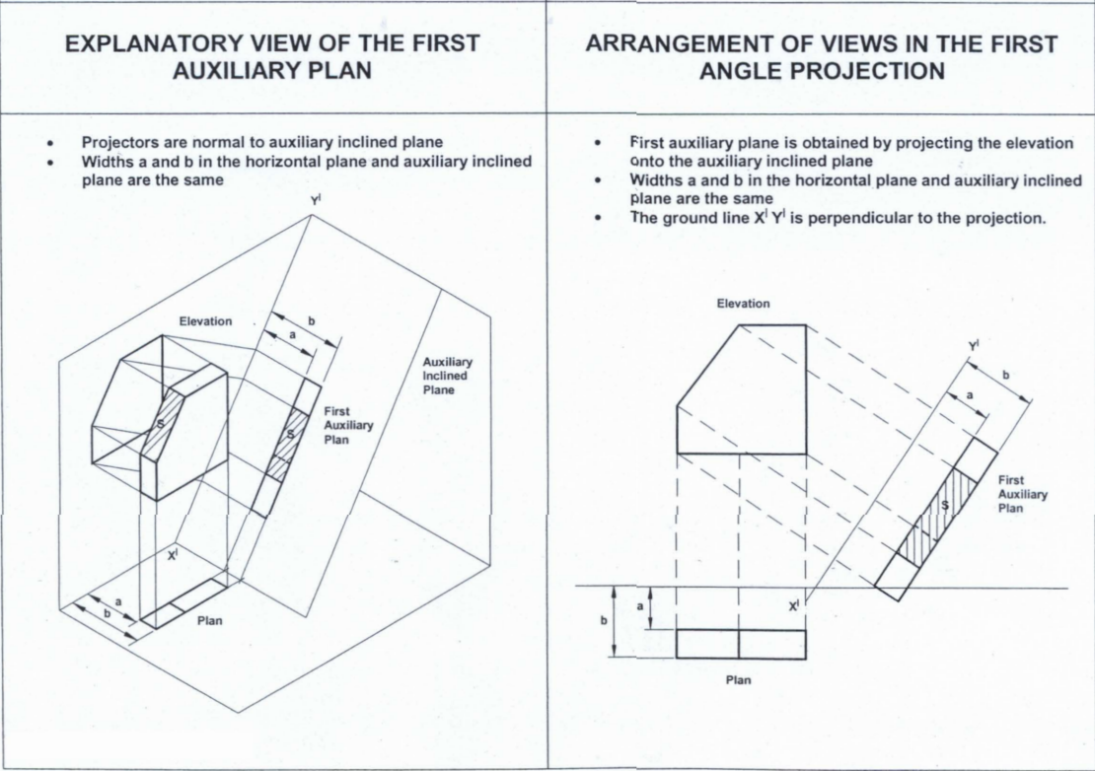
WEEK 5 – Auxiliary Projection

Slide 36
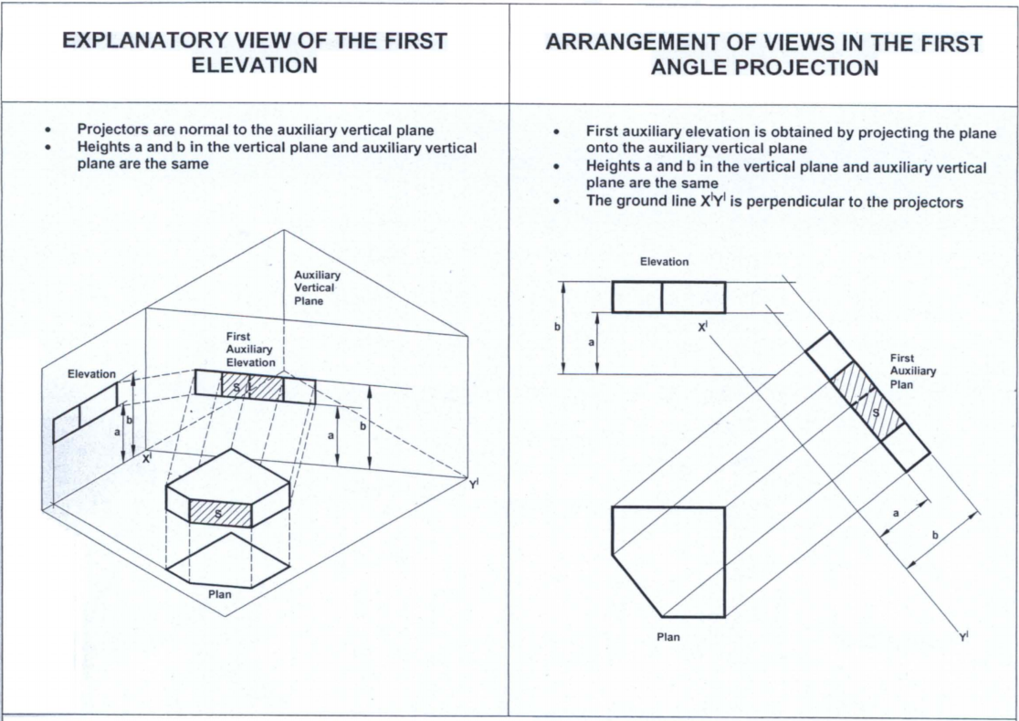
WEEK 5 – Auxiliary Projection

